Slide 1
Logistic Regression

Slide 2
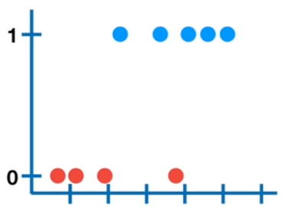
Why not linear regression?
Age | Buy_indicator
6 | 0
25 | 0
10 | 0
12 | 0
5 | 0
20 | 0
32 | 1
44 | 1
34 | 1
43 | 1
72 | 1
67 | 0
58 | 1
58 | 1

Slide 3
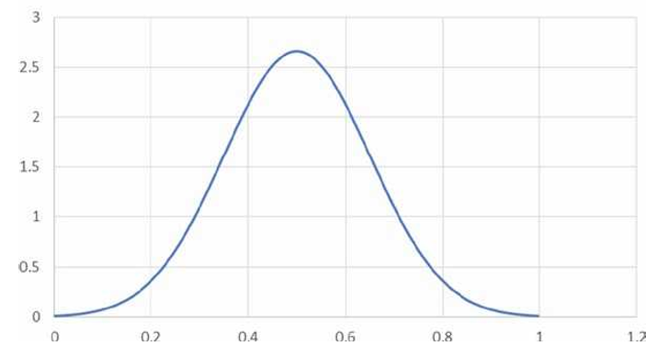
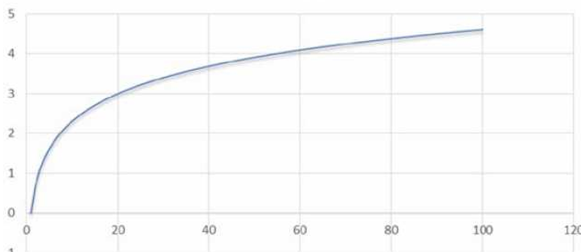
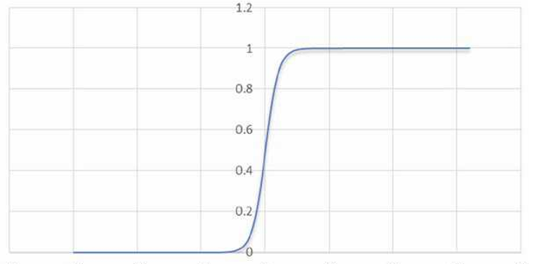
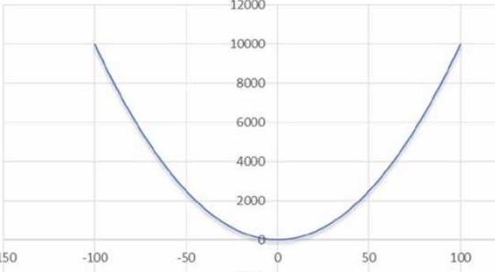
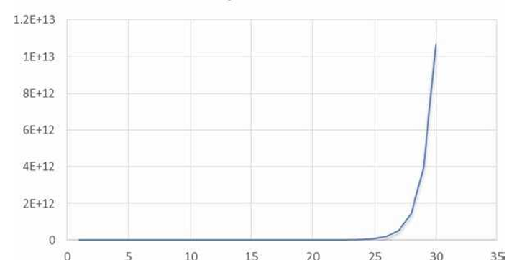
Gaussian normal distribution
Y = log(X)
Logit function
Y = e^{x}
Y =X²

Slide 4
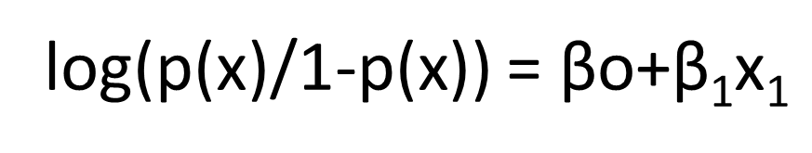


Logistic regression equation
$$\text{log}\text{(}\text{Y}\text{/1−}\text{Y}\text{) = }\text{βo}\text{+ }\text{β}\text{1}\text{x}\text{1}$$
$$\text{Log} \text{of} \text{odds}$$
If, y = p(x)
log(p(x)/1-p(x)) = $\text{βo}\text{+}\text{β}\text{1}\text{x}\text{1}$
log(p(x)/1-p(x)) = $\text{βo}\text{+}\text{β}\text{1}\text{x}\text{1+}\text{β}\text{2}\text{x}\text{2+}\text{β}\text{3}\text{x}\text{4+}\text{β}\text{4}\text{x}\text{4+ }….\text{+}\text{βpxp}$

Slide 5

If it is not a good day, Odds in favor of buying ice cream is 1 to 4
Odds = (1/5)/(4/5) = 1/4 =0.25

Slide 6
If it is a bad day, Odds in favor of buying ice cream is 1 to 7
Odds = (1/8)/(7/8) = 1/7 =0.14

Slide 7
If it is a worst day, Odds in favor of buying ice cream 1 to 15
Odds = (1/16)/(15/16) = 1/15 =0.06

Slide 8
If it is a good day, Odds in favor of buying ice cream 4 to 1
Odds = (4/5)/(1/5) = 4/1 =4

Slide 9
If it is a better day, Odds in favor of buying ice cream 7 to 1
Odds = (7/8)/(1/8) = 7/1 =7

Slide 10
If it is best day, Odds in favor of buying ice cream is 15 to 1
Odds = (15/16)/(1/16) = 15/1 =15

Slide 11
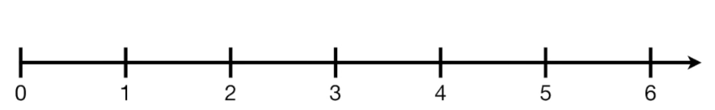
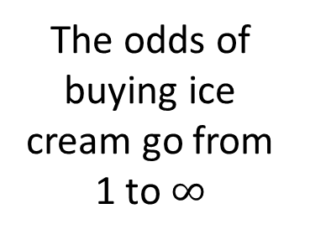

The odds of not buying ice cream go from 0 to 1
The odds of buying ice cream go from 1 to $∞$
$$∞$$

Slide 12
Odds = (1/16)/(15/16) = 1/15 =0.06
log(odds) = log(1/15) = -1.204

Slide 13
Odds = (15/16)/(1/16) = 15/1 =15
Log(odds) = log(15) = 1.204

Slide 14
Simple math…
On a worst day:
log(odds) = log(1/15)
= log(1) – log(15)
= 0 - 1.204
= -1.204
On a Best day:
log(odds) = log(15)
= 1.204

Slide 15
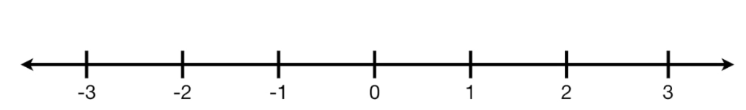
The log(odds) of buying or not buying the ice cream becomes symmetrical
-1.204
1.204

Slide 16
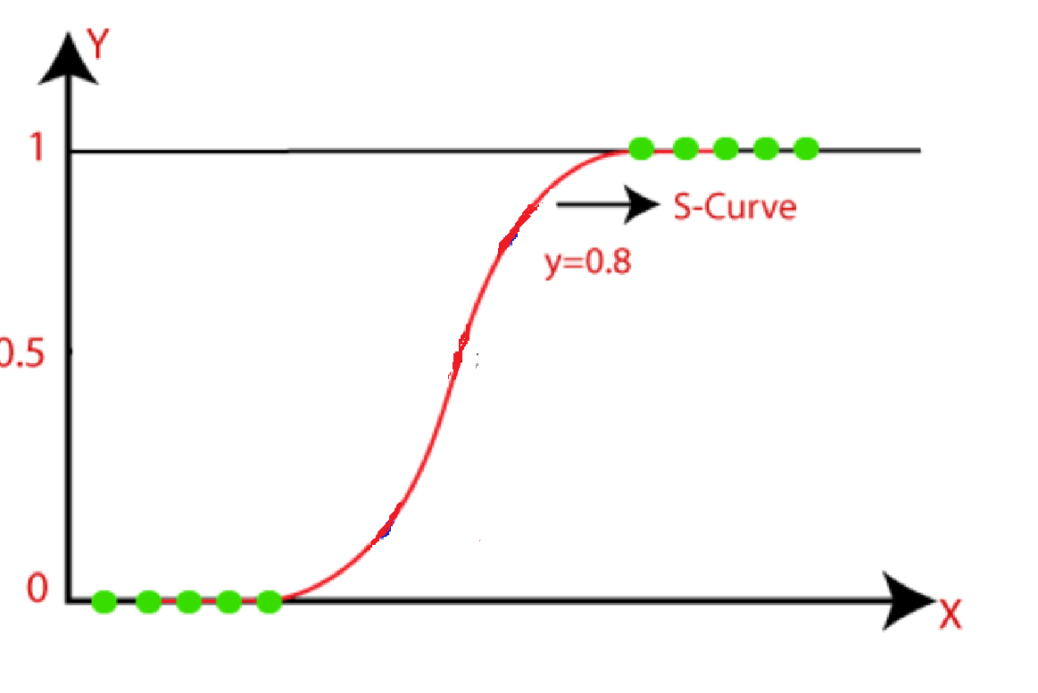

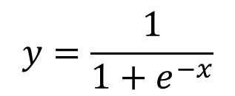
$$y=\frac{1}{1+e^{−x}}$$

Slide 17
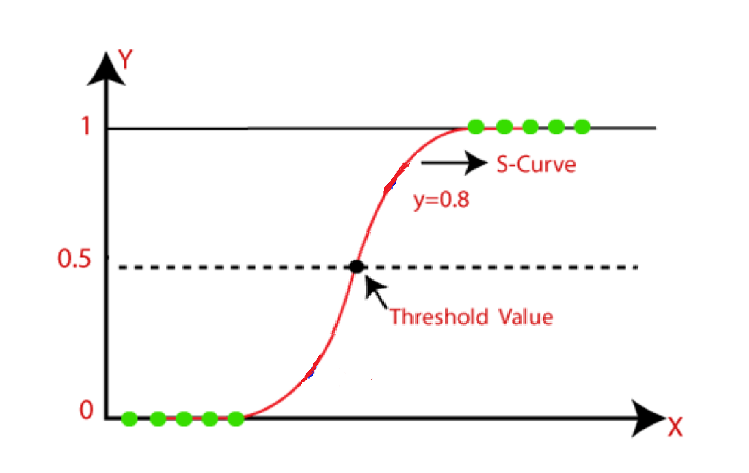

Slide 18
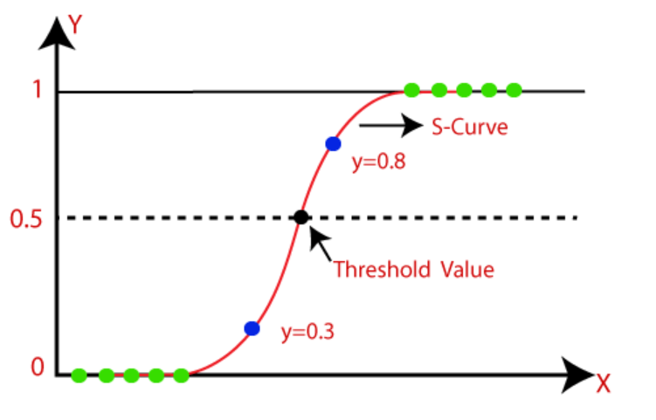

Slide 19
Ice cream is bought

Slide 20
Ice cream is not bought

Slide 21
Curve1

Slide 22
Curve2

Slide 23
Curve3

Slide 24
Y = log(p/1-p)

Slide 25
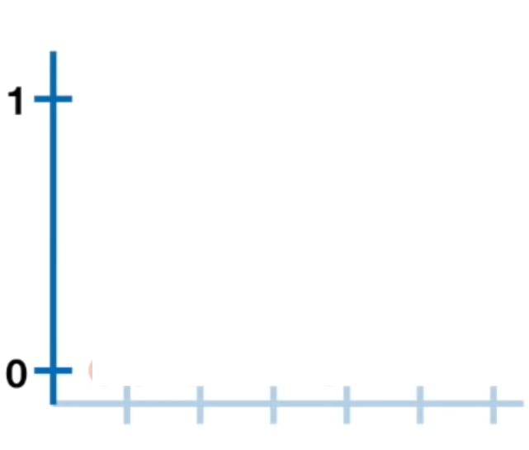
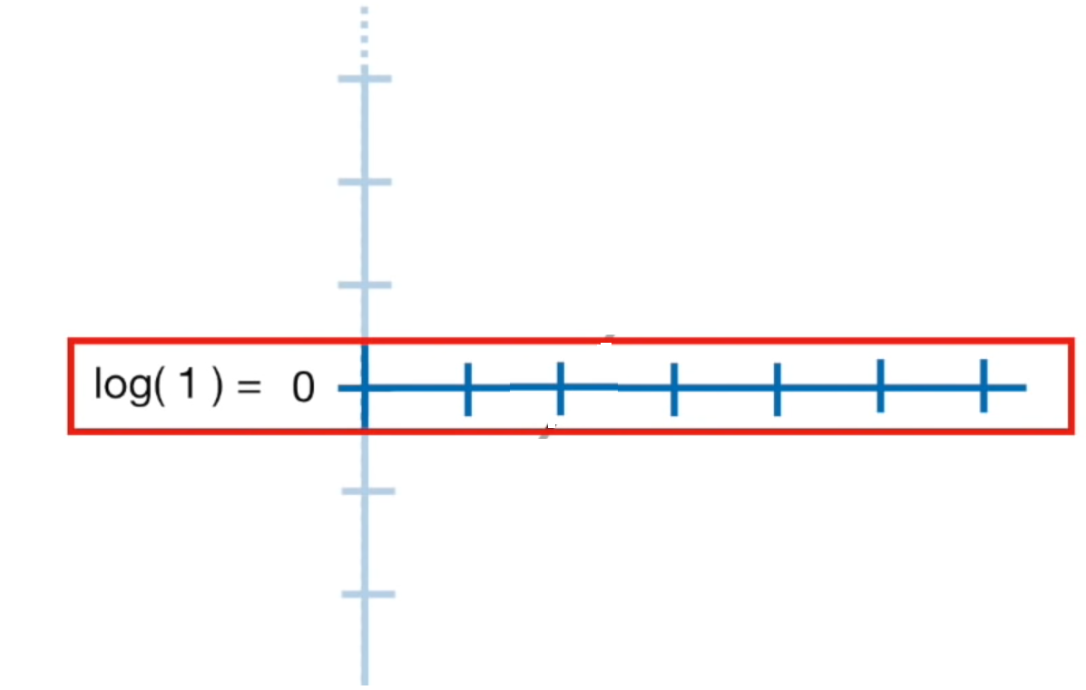
If P = 0.5,
Y = log(0.5/1-0.5)
= log(1)
= 0

Slide 26
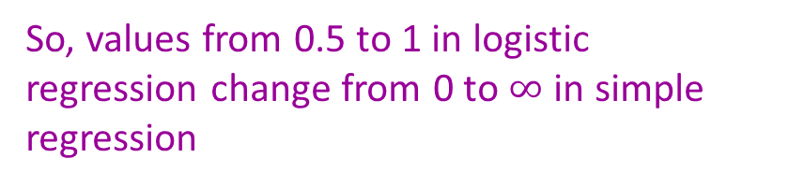
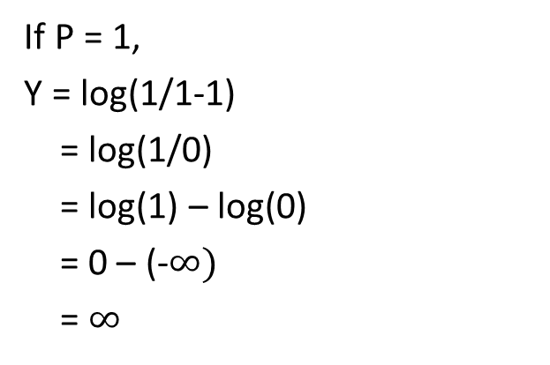
If P = 0.73,
Y = log(0.73/1-0.73)
= log(0.731/0.269)
= 1
If P = 0.88,
Y = log(0.88/1-0.88)
= log(0.88/0.22)
= 2
If P = 1,
Y = log(1/1-1)
= log(1/0)
= log(1) – log(0)
= 0 – (-$∞)$
= $∞$
So, values from 0.5 to 1 in logistic regression change from 0 to $∞$ in simple regression

Slide 27
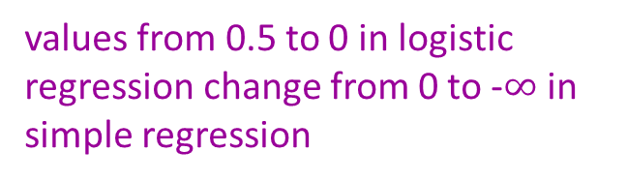
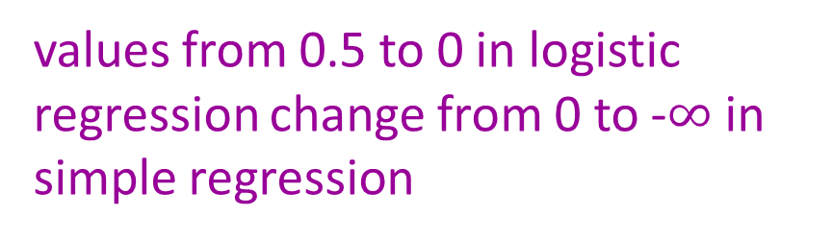
values from 0.5 to 0 in logistic regression change from 0 to -$∞$ in simple regression

Slide 28
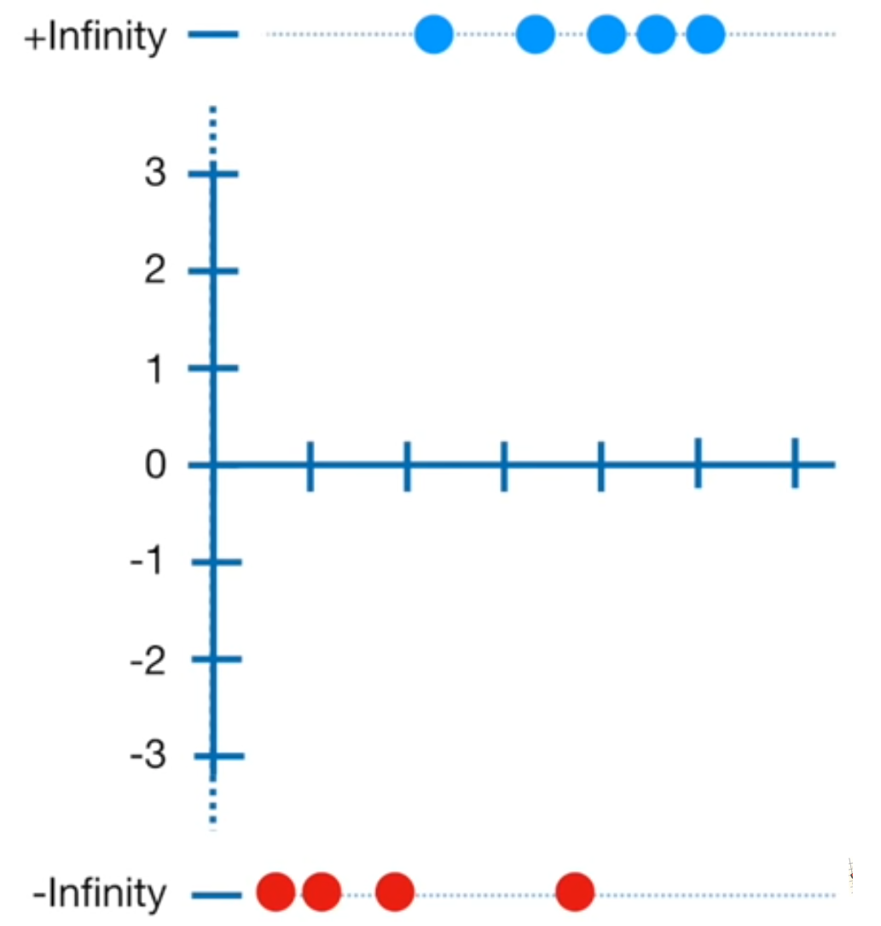
Log(odds of buying ice cream)

Slide 29
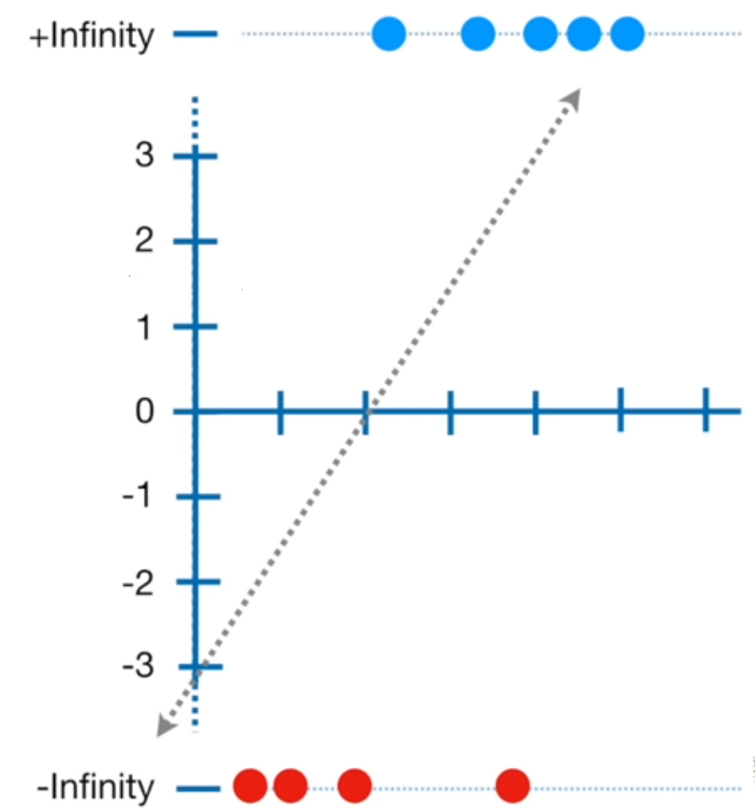
So, we cannot use ordinary least squares method

Slide 30
We use method of maximum likelihood estimation

Slide 31
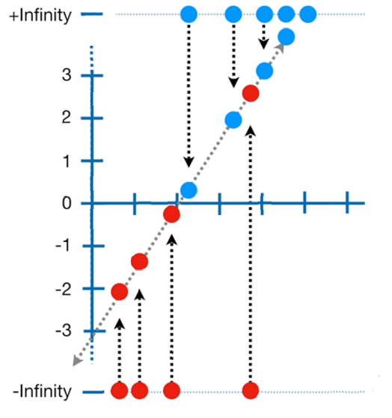
We use method of maximum likelihood estimation

Slide 32
-2.1

Slide 33
-1.5
e^{log(odds)}
p =
(1+e^{log(odds)})

Slide 34
log(odds)
= log(p(x)/1-p(x))
→ log(p/1-p) = log(odds)
(p/1-p) = e^{log(odds)}
=> p = (1-p)*e^{log(odds)}
=> p+p*e^{log(odds)} = e^{log(odds)}
=> p(1+e^{log(odds)}) = e^{log(odds)}
e^{log(odds)}
P =
(1+e^{log(odds)})

Slide 35
e^{log(odds)}
P =
(1+e^{log(odds)})
e^{-2.1}
P =
(1+e^{-2.1})
P = 0.1

Slide 36
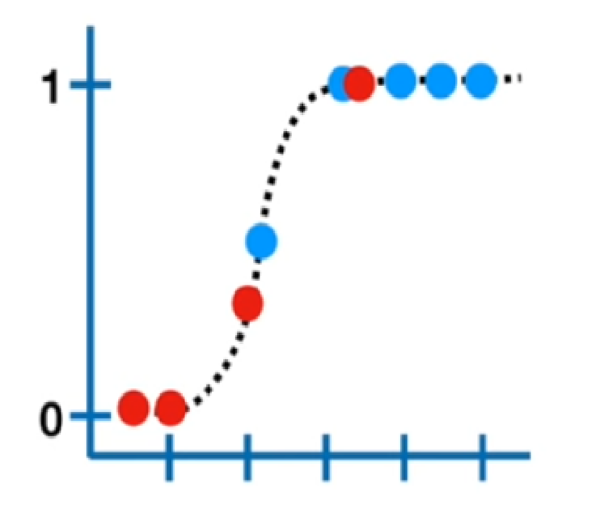
0.49

Slide 37
0.9

Slide 38
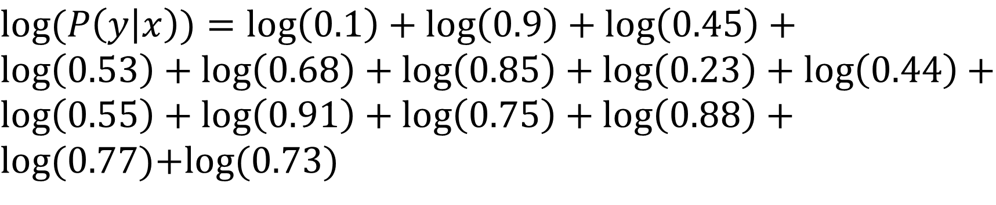
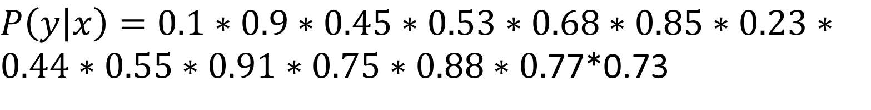
$P\left(\left.y\right|x\right)=0.1∗0.9∗0.45∗0.53∗0.68∗0.85∗0.23∗0.44∗0.55∗0.91∗0.75∗0.88∗0.$77*0.73
$log(P\left(\left.y\right|x\right))=log\left(0.1\right)+log\left(0.9\right)+log\left(0.45\right)+log\left(0.53\right)+log\left(0.68\right)+log\left(0.85\right)+log\left(0.23\right)+log\left(0.44\right)+log\left(0.55\right)+log\left(0.91\right)+log\left(0.75\right)+log\left(0.88\right)+log(0.$77)+log(0.73)
$$\log\left(P\left(\left.y\right|x\right)\right)=−2.5$$

Slide 39
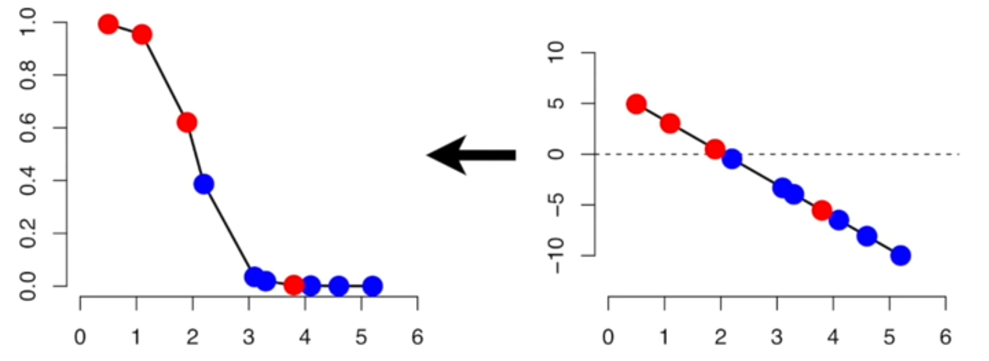

Slide 40
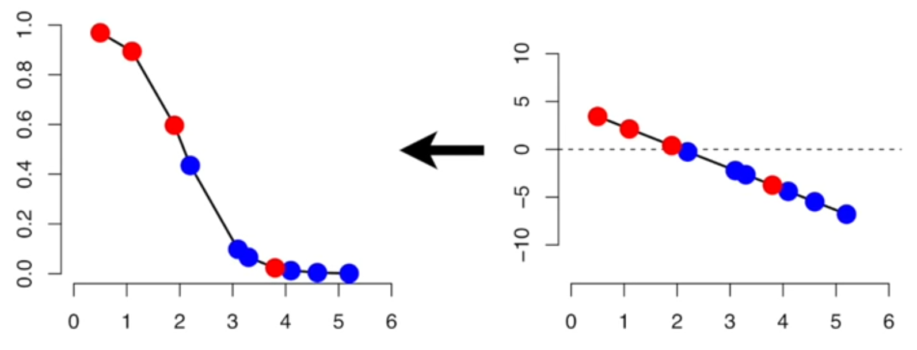

Slide 41
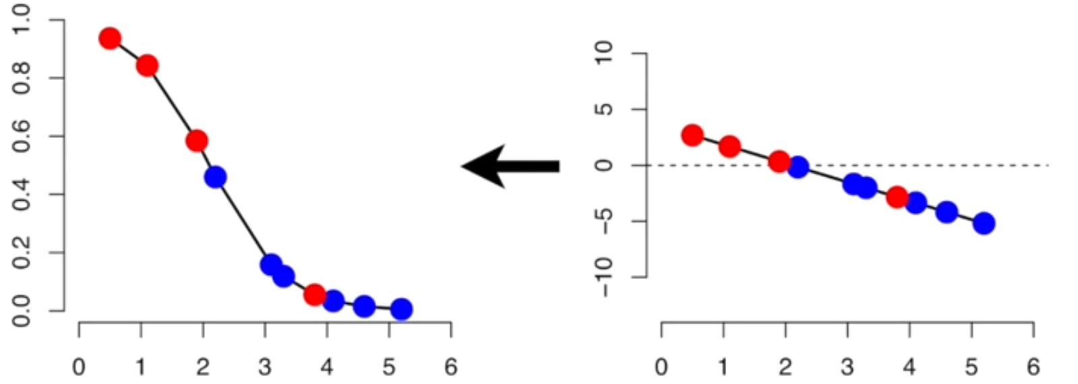

Slide 42
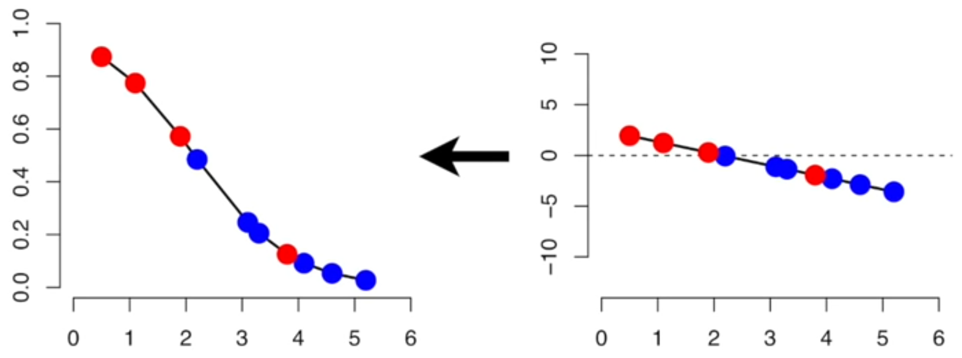

Slide 43
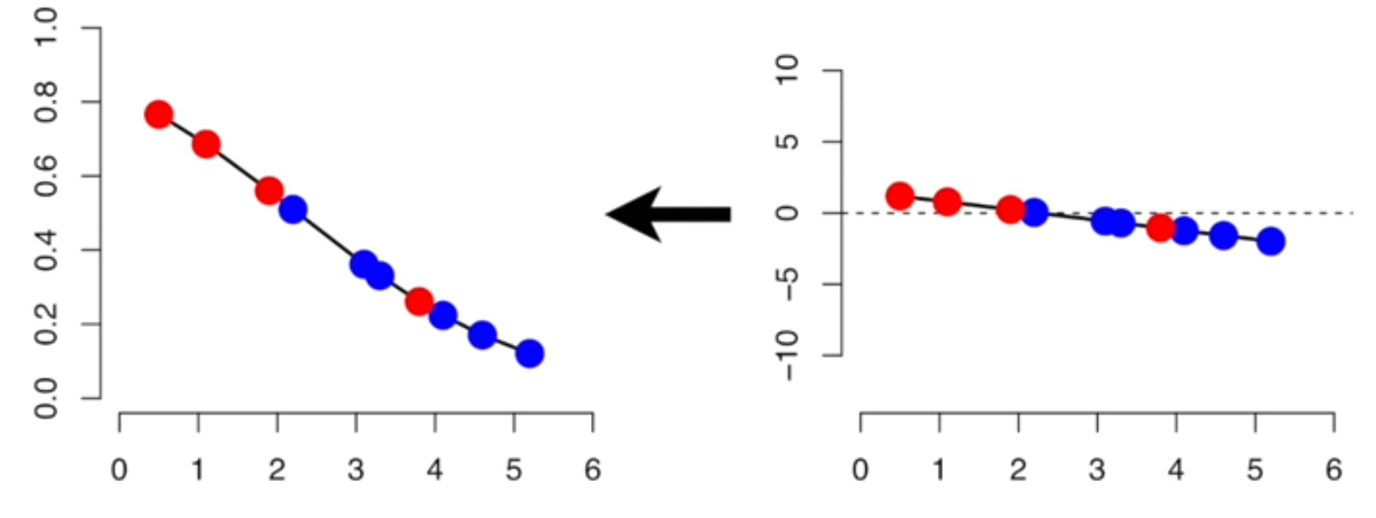

Slide 44
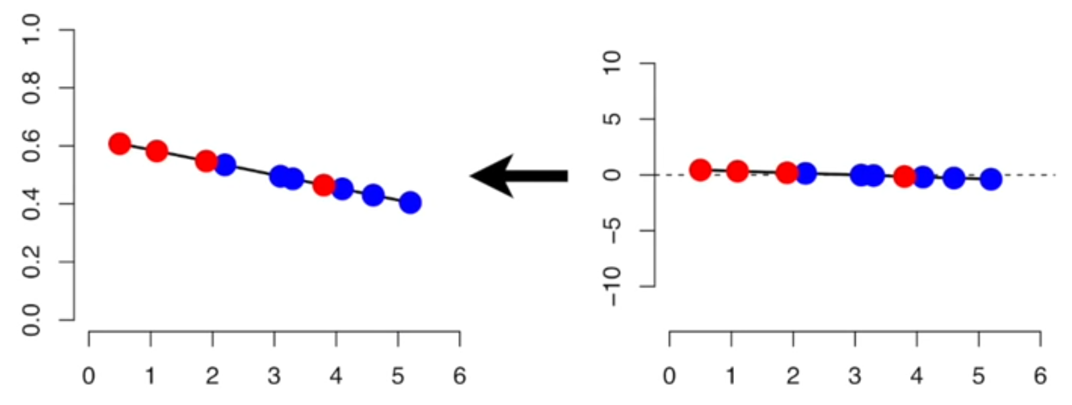

Slide 45
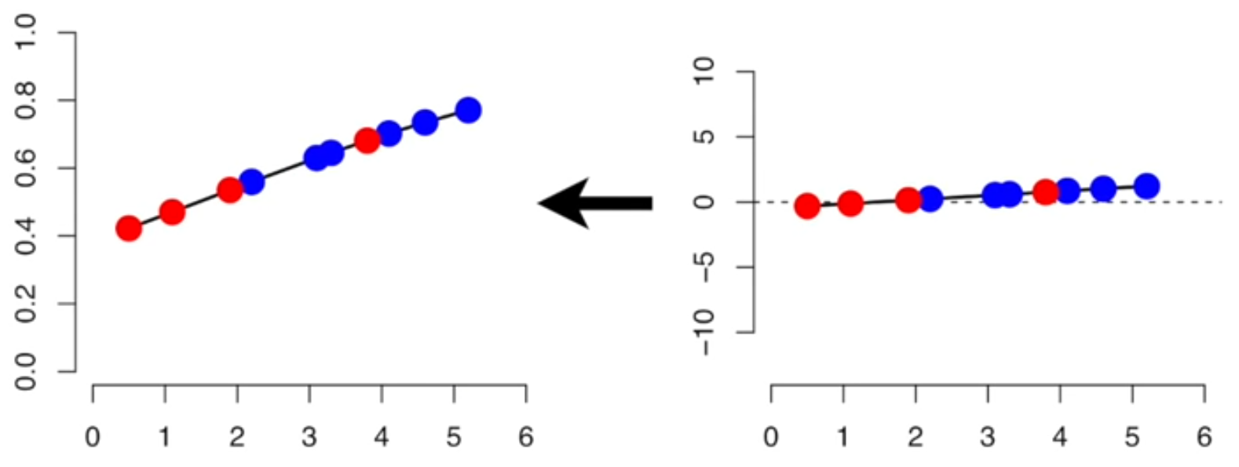

Slide 46
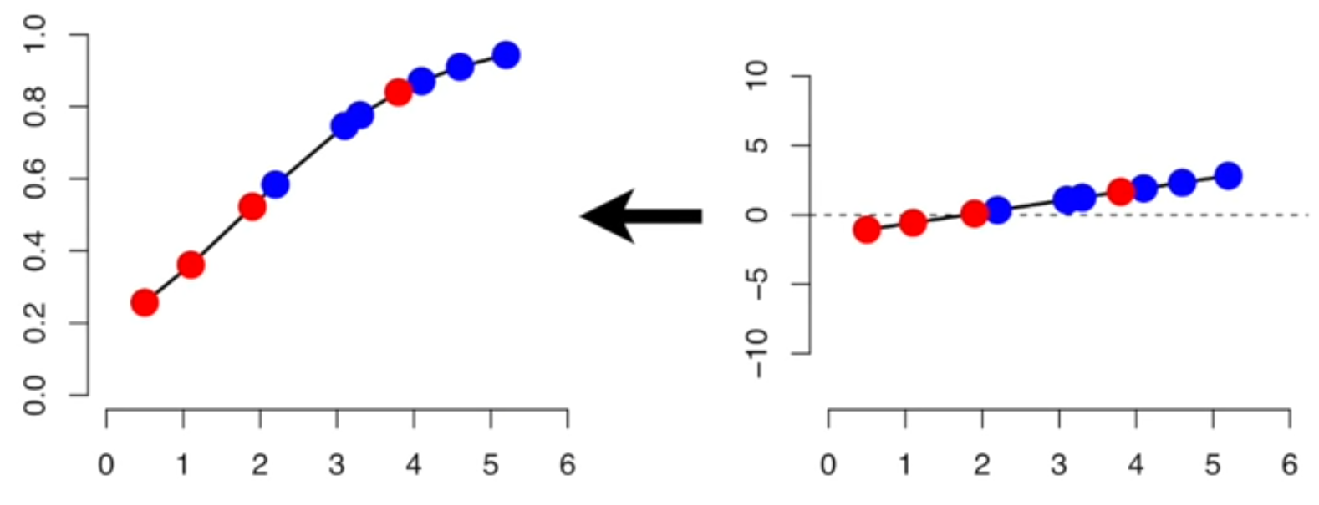

Slide 47
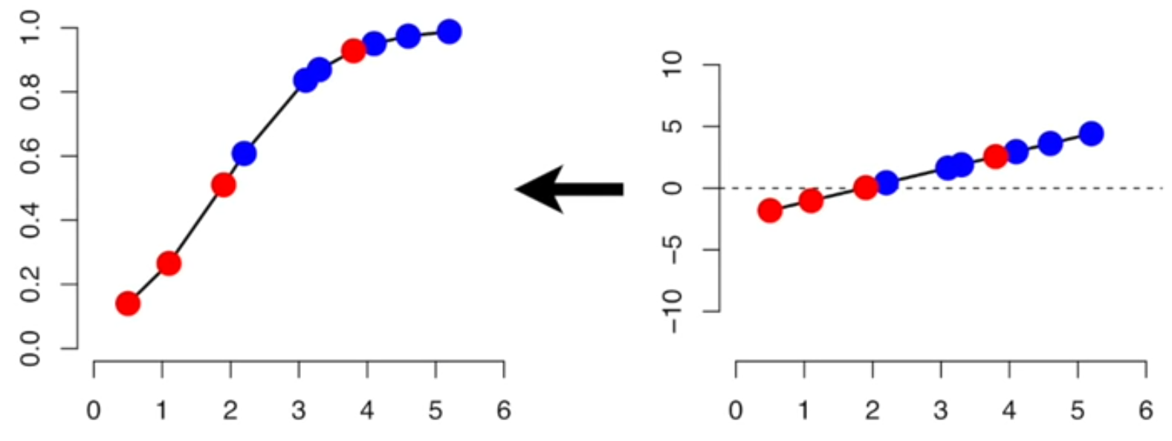

Slide 48
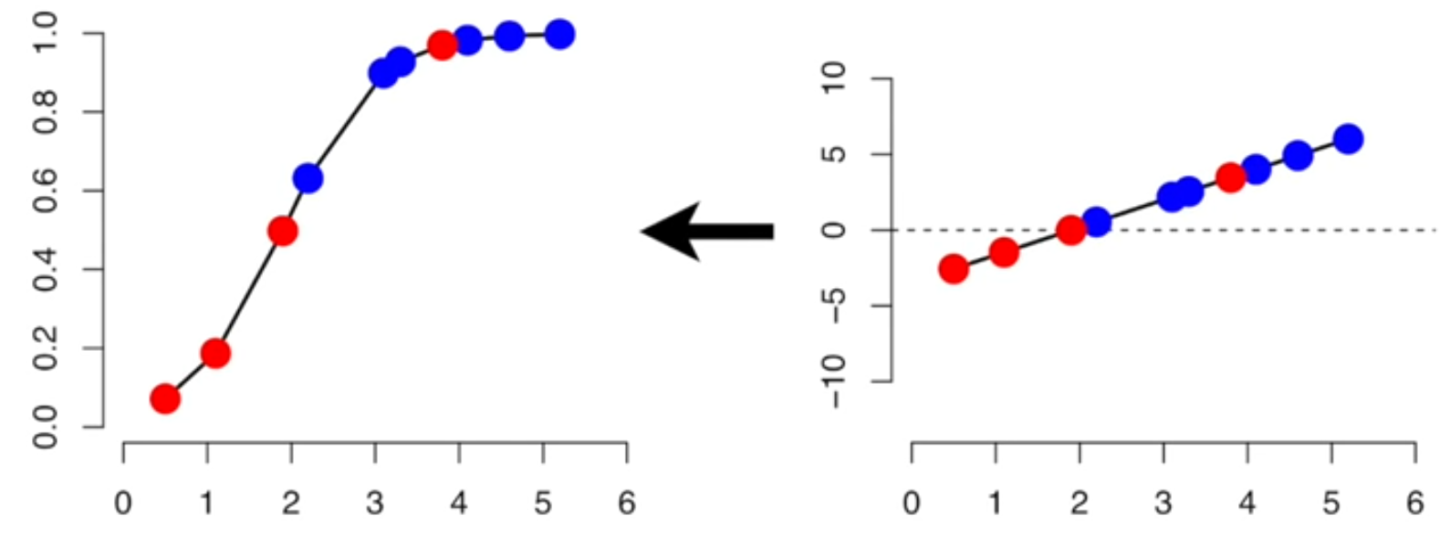

Slide 49
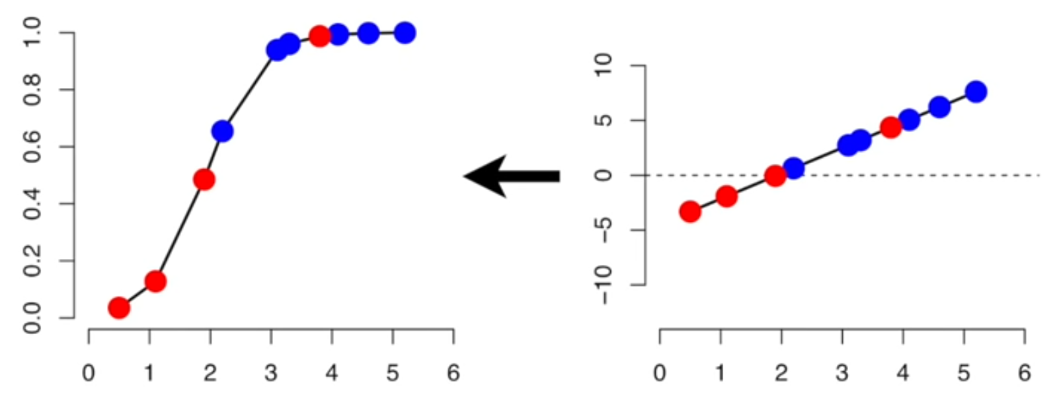

Slide 50
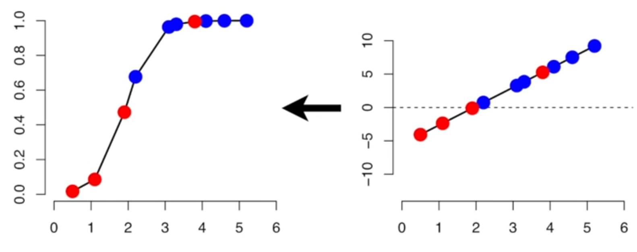

Slide 51
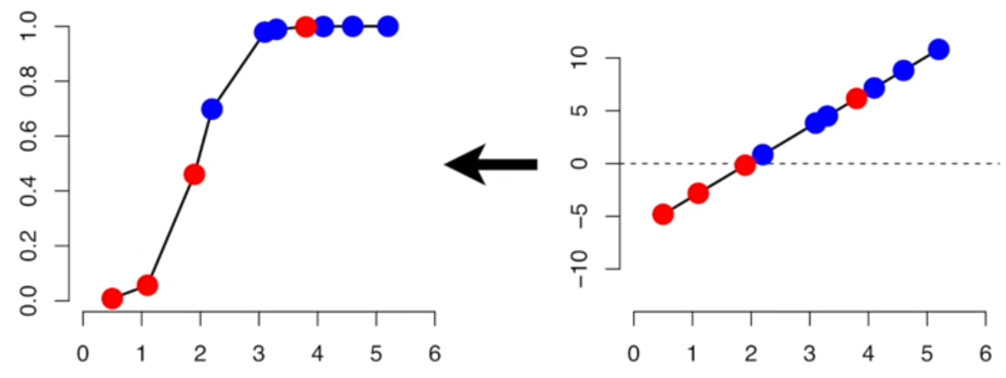

Slide 53
Say, you have 3 models with overall likelihood values as -3, -4.25 and -1.5
A model with the maximum value of likelihood is the best model

Slide 54
Model Validation in Logistic regression

Slide 55
Validation metrics
AIC value
Accuracy
Precision
sensitivity/Recall
Specificity
F1-Score
ROC curve

Slide 56
Confusion matrix
 |  | Actuals
Predictions |  | 1 | 0
 | 1
 | 0

Slide 57
Confusion matrix
 |  | Actuals
Predictions |  | 1 | 0
 | 1 | 70 | 30
 | 0 | 30 | 70

Slide 58
Confusion matrix
 |  | Actuals
Predictions |  | 1 | 0
 | 1 | 70 (TP) | 30
 | 0 | 30 | 70

Slide 59
Confusion matrix
 |  | Actuals
Predictions |  | 1 | 0
 | 1 | 70 (TP) | 30
 | 0 | 30 | 70 (TN)

Slide 60
Confusion matrix
 |  | Actuals
Predictions |  | 1 | 0
 | 1 | 70 (TP) | 30
 | 0 | 30 (FN) | 70 (TN)

Slide 61
Confusion matrix
 |  | Actuals
Predictions |  | 1 | 0
 | 1 | 70 (TP) | 30 (FP)
 | 0 | 30 (FN) | 70 (TN)

Slide 62
Accuracy
 |  | Actuals
Predictions |  | 1 | 0
 | 1 | 70 (TP) | 30 (FP)
 | 0 | 30 (FN) | 70 (TN)
Intuition - What percentage of predictions are correct

Slide 63
Accuracy
 |  | Actuals
Predictions |  | 1 | 0
 | 1 | 70 (TP) | 30 (FP)
 | 0 | 30 (FN) | 70 (TN)
Intuition - What percentage of predictions are correct

Slide 64
Accuracy
 |  | Actuals
Predictions |  | 1 | 0
 | 1 | 70 (TP) | 30 (FP)
 | 0 | 30 (FN) | 70 (TN)
Intuition - What percentage of predictions are correct
TP+TN
Accuracy =
TP+TN+FP+FN

Slide 65
Specificity
 |  | Actuals
Predictions |  | 1 | 0
 | 1 | 70 (TP) | 30 (FP)
 | 0 | 30 (FN) | 70 (TN)
Intuition - What percentage of 0s are correctly predicted

Slide 66
Specificity
 |  | Actuals
Predictions |  | 1 | 0
 | 1 | 70 (TP) | 30 (FP)
 | 0 | 30 (FN) | 70 (TN)
Intuition - What percentage of 0s are correctly predicted

Slide 67
Specificity
 |  | Actuals
Predictions |  | 1 | 0
 | 1 | 70 (TP) | 30 (FP)
 | 0 | 30 (FN) | 70 (TN)
Intuition - What percentage of 0s are correctly predicted

Slide 68
Specificity
 |  | Actuals
Predictions |  | 1 | 0
 | 1 | 70 (TP) | 30 (FP)
 | 0 | 30 (FN) | 70 (TN)
Intuition - What percentage of 0s are correctly predicted
TN
Specificity =
TN+FP

Slide 69
Sensitivity/Recall
 |  | Actuals
Predictions |  | 1 | 0
 | 1 | 70 (TP) | 30 (FP)
 | 0 | 30 (FN) | 70 (TN)
Intuition - What percentage of 1s are correctly predicted

Slide 70
Sensitivity/Recall
 |  | Actuals
Predictions |  | 1 | 0
 | 1 | 70 (TP) | 30 (FP)
 | 0 | 30 (FN) | 70 (TN)
Intuition - What percentage of 1s are correctly predicted

Slide 71
Sensitivity/Recall
 |  | Actuals
Predictions |  | 1 | 0
 | 1 | 70 (TP) | 30 (FP)
 | 0 | 30 (FN) | 70 (TN)
Intuition - What percentage of 1s are correctly predicted

Slide 72
Sensitivity/Recall
 |  | Actuals
Predictions |  | 1 | 0
 | 1 | 70 (TP) | 30 (FP)
 | 0 | 30 (FN) | 70 (TN)
Intuition - What percentage of 1s are correctly predicted
TP
Sensitivity =
TP+FN

Slide 73
Precision
 |  | Actuals
Predictions |  | 1 | 0
 | 1 | 70 (TP) | 30 (FP)
 | 0 | 30 (FN) | 70 (TN)
Intuition - What percentage of predictions are 1s

Slide 74
Precision
 |  | Actuals
Predictions |  | 1 | 0
 | 1 | 70 (TP) | 30 (FP)
 | 0 | 30 (FN) | 70 (TN)
Intuition - What percentage of predictions are 1s

Slide 75
Precision
 |  | Actuals
Predictions |  | 1 | 0
 | 1 | 70 (TP) | 30 (FP)
 | 0 | 30 (FN) | 70 (TN)
Intuition - What percentage of predictions are 1s

Slide 76
Precision
 |  | Actuals
Predictions |  | 1 | 0
 | 1 | 70 (TP) | 30 (FP)
 | 0 | 30 (FN) | 70 (TN)
Intuition - What percentage of predictions are 1s
TP
Precision =
TP+FP

Slide 77
Precision vs Recall
Precision
Recall
What percentage of predictions are 1s
What percentage of 1s are correctly predicted
True positives
Precision =
True positives
Recall =
Actual positives
Predicted positives
TP
TP
Precision =
Recall =
TP+FP
TP+FN

Slide 78
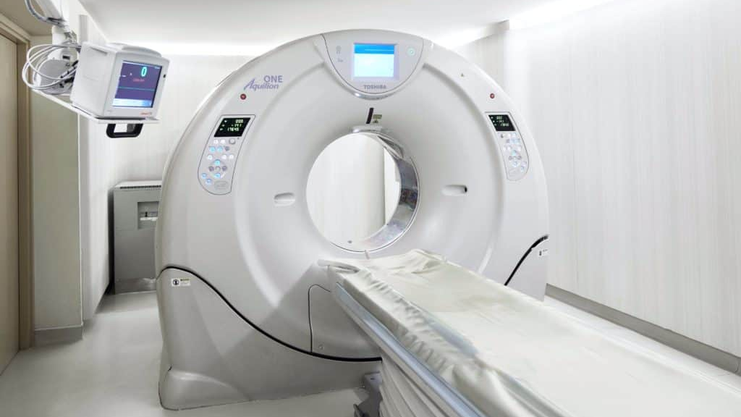

Slide 79
Precision vs Recall
High Precision
High Recall
Threshold = 0.9
Machine only predicts patients with serious cancer
Threshold = 0.3
Machine predicts almost everyone has cancer

Slide 80
What is the best Threshold?
Model No: | Precision | Recall
1 | 0.5 | 0.4
2 | 0.7 | 0.1
3 | 0.02 | 1.0
P+R
Average =
2

Slide 81
What is the best Threshold?
Model No: | Precision | Recall | Average
1 | 0.5 | 0.4 | 0.45
2 | 0.7 | 0.1 | 0.1
3 | 0.02 | 1.0 | 0.51

Slide 82
F1-Score
2*P*R
F1-Score =
P+R
If any value of P or R is 0, model is marked as inefficient
Model No: | Precision | Recall | Average | F1-Score
1 | 0.5 | 0.4 | 0.45 | 0.444
2 | 0.7 | 0.1 | 0.1 | 0.175
3 | 0.02 | 1.0 | 0.51 | 0.0392

Slide 83
ROC Curve
Used to select an optimized model
AIC
(Akaike information criterion)
AIC should be low for a good model

Slide 84
Variable selection
Significant variables can be selected using P-values of chi-square test following step-wise selection.

Slide 85
Assumptions of logistic regression
Target/output variable is dichotomous in nature
No multicollinearity between independent variables
log(odds) is in linear relationship with input variables

